Slide 1
The Model on data
Reverse-engineering a hidden mixture distribution behind a linear regression task
Qianyue lu
Kaggle Linear Regression Challenge · Spring 2026
Notes:
Hello everyone. I worked on this linear regression challenge - predicting a continuous target from 15 anonymous features. I want to start with how I investigated the data, because my entire model was derived from those observations, not the other way around. I did not pick a model and then force the data into it.

Slide 2
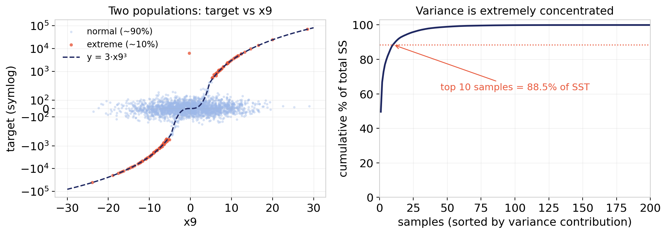
First I investigated the data (1 of 2)
1 / 6
1 · It looks like regression, but it is a mixture
~90% normal: target is a linear combination of features (mainly x4, x8, x3, x2).
~10% extreme: same linear part plus an extra 3·x9³ term.
2 · The 10% dominates everything
Extreme samples = 99.3% of total variance; the top 10 alone = 88.5%.
Since R² punishes large errors heavily, a perfect fit on the 90% barely moves the score — and a plain linear model scores ≈ 0 because it is dragged off by these points yet cannot predict them.
Notes:
Before building anything, I investigated the data, and I had five observations. First: it looks like an ordinary regression, but it is actually a mixture of two populations. About 90 percent of samples - the target is a linear combination of the features. But about 10 percent carry an extra 3 times x9 cubed term on top of that same linear part. You can see it in the left plot - the red points sit exactly on the cubic curve. Second observation: that 10 percent, though small, dominates everything. The extreme samples are 99.3 percent of the total variance; the top ten samples alone are 88.5 percent. Because R-squared is so sensitive to large errors, even a perfect fit on the normal 90 percent barely moves the score. This is exactly why a plain linear regression scores near zero - it gets dragged off by the extremes but still cannot predict them.

Slide 3
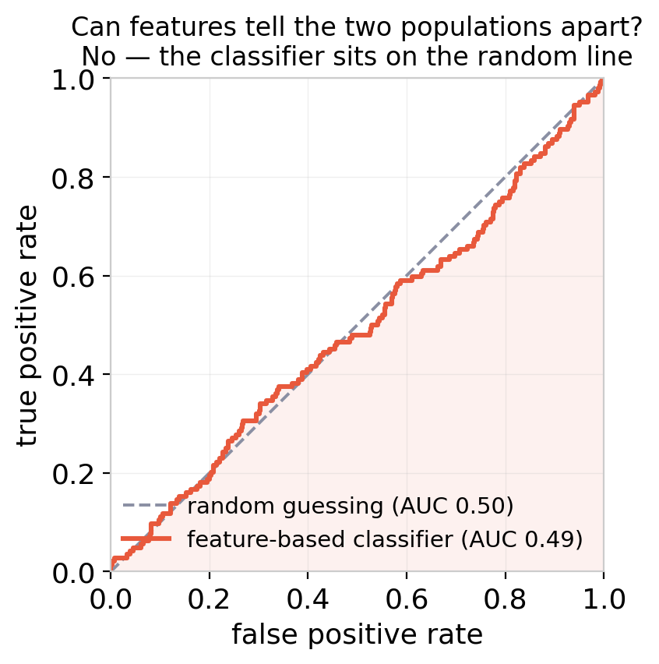
First I investigated the data (2 of 2)
2 / 6
3 · The cubic pattern is almost exact
The extreme targets equal 3·x9³ with correlation 0.998 — not an approximation, so it is engineered, not noise.
4 · It is addition, not replacement
Subtracting 3·x9³ from the extremes leaves exactly the linear prediction (corr 0.974, slope ≈ 1). So the cube sits on top of the linear structure — meaning their clean linear signal is still usable for training once the cube is removed.
5 · The two types cannot be told apart from features
This is the key, hardest observation. A classifier trying to separate cubic from normal samples scores AUC ≈ 0.49 — chance level (see right). The types are identical in feature space, so on the test set (no target) I cannot know which is which. I therefore cannot “classify then predict” — I must treat every sample by probability.
Notes:
Three more observations. Third: the cubic pattern is almost exact - the extreme targets match 3 x9 cubed with correlation 0.998. That precision tells me it is engineered, not random noise. Fourth: it is addition, not replacement. When I subtract the cubic term from the extreme samples, what is left is exactly the linear prediction - correlation 0.974, slope near one. So the cube sits on top of the linear structure; this matters because it means those samples, once the cube is removed, still give me usable clean linear signal. Fifth, and this is the most important and trickiest one: the two types cannot be told apart from the features. I trained a classifier to separate cubic from normal samples and it scored AUC 0.49 - you can see on the right, the curve sits right on the random diagonal. They are identical in feature space. So on the test set, where I cannot see the target, I have no way to know which sample is which. That rules out classify-then-predict, and forces me to treat every sample by probability.

Slide 4
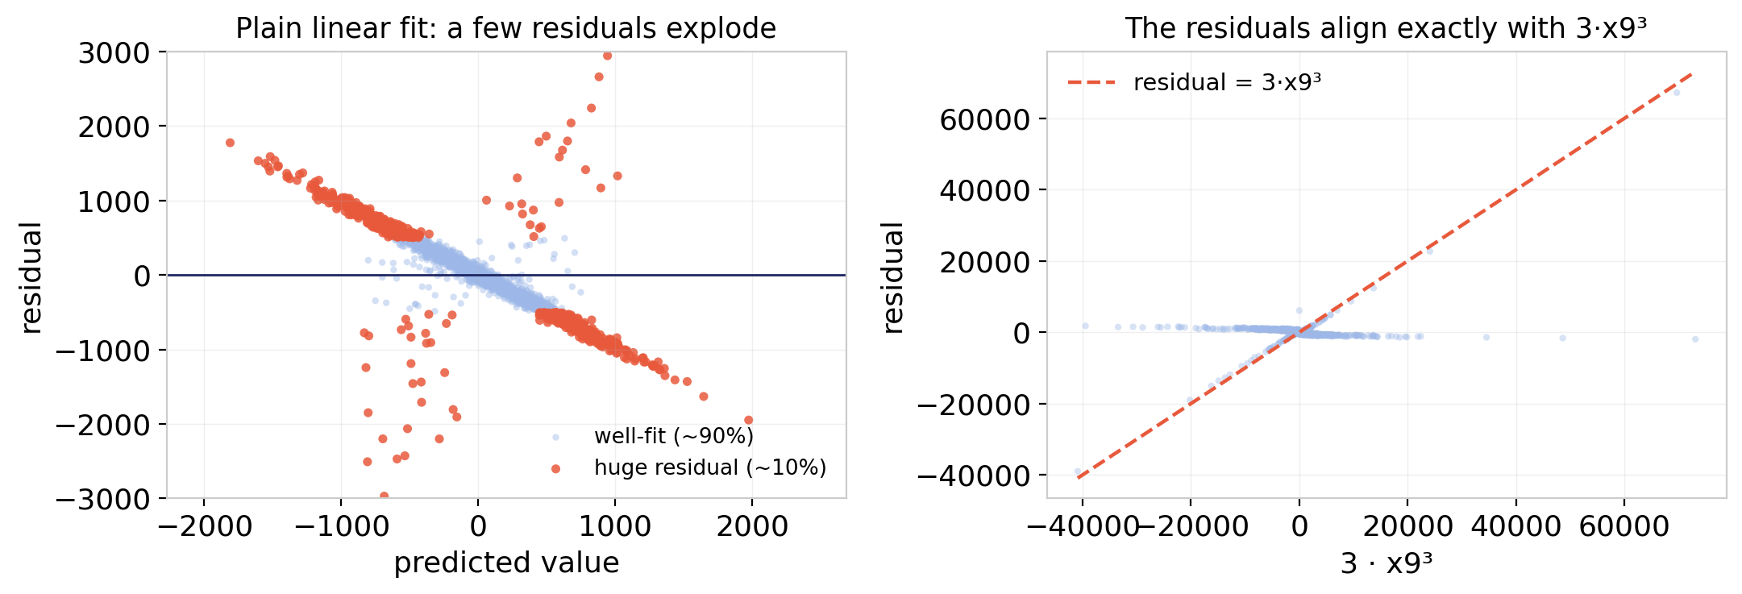
How I found this: a baseline that exposed the problem
3 / 6
I first ran a baseline on purpose — to let the problem surface.
Standard pipeline: median-impute → standardize → Ridge → 10-fold CV. The cross-validated R² came out near zero.
That is strange for a “linear regression” task, so instead of reaching for a fancier model I looked at the residuals.
Most points fit fine, but ~10% had residuals in the thousands — and plotting those against 3·x9³ (right) showed they line up exactly. That single diagnosis revealed the cubic term.
Residuals were a one-time diagnostic, not something I kept tuning.
Once they revealed “there is a cubic term,” that finding was written permanently into the model structure. Everything after — identifying the cubic samples, subtracting the term, adding it back by probability — changes the model, not the residuals. The residuals’ job ended after the first diagnosis.
Notes:
Now how did I find all this. I first ran a baseline on purpose, to let the problem surface. Standard pipeline - impute, standardize, Ridge, ten-fold cross-validation. The R-squared came out near zero. That is strange for something literally called a linear regression challenge, so rather than reaching for a fancier model, I looked at the residuals. Most points fit fine, but about ten percent had residuals in the thousands, and when I plotted those residuals against x9 cubed - the right panel - they lined up exactly. That one diagnosis revealed the cubic term. And I want to stress: the residuals were a one-time diagnostic tool, not something I kept tuning. Once they told me there is a cubic term, that finding was baked permanently into the model structure. Everything afterward changes the model, not the residuals.

Slide 5
The model: linear part + a probability-weighted cube
4 / 6
prediction = Ridge(x) + w × 3·x9³
1
Clean the training target
2
Fit each part with the right tool
3
Add the cube back by probability
In training I can see the target, so cubic samples are identifiable. I flag them and subtract 3·x9³, so the linear model trains on clean, uncontaminated data.
Linear part → Ridge (matches the true mechanism). Cubic part → the analytic 3·x9³, which extrapolates exactly to any x9.
On the test set the types are indistinguishable, so I add a fraction of the cube to every sample — the expected value over the mixture.
Where does the weight w come from? Not guessed. From observation 5: since the types are indistinguishable, each sample’s probability of being cubic is fixed at ~10%. The MSE-optimal prediction for an unidentifiable mixture is exactly the probability-weighted average — so w ≈ 0.1 follows directly from “cannot be told apart.”
Notes:
So the model itself is simple - one formula: prediction equals the linear part, Ridge, plus a weight times 3 x9 cubed. The linear part handles the 90 percent normal samples, the cubic term handles the 10 percent extremes. Three steps. One: in training I can see the target, so I identify the cubic samples and subtract their cubic part, letting the linear model train on clean data. Two: Ridge for the linear part, the explicit cubic formula for the cubic part. Three: at prediction time I add the cube back by weight. Now where does that weight come from? It is not guessed. Go back to observation five - since the types cannot be told apart, every sample has the same fixed probability, about 10 percent, of being cubic. The mathematically optimal prediction for an unidentifiable mixture is precisely the probability-weighted average. So w around 0.1 follows directly from cannot be told apart.

Slide 6
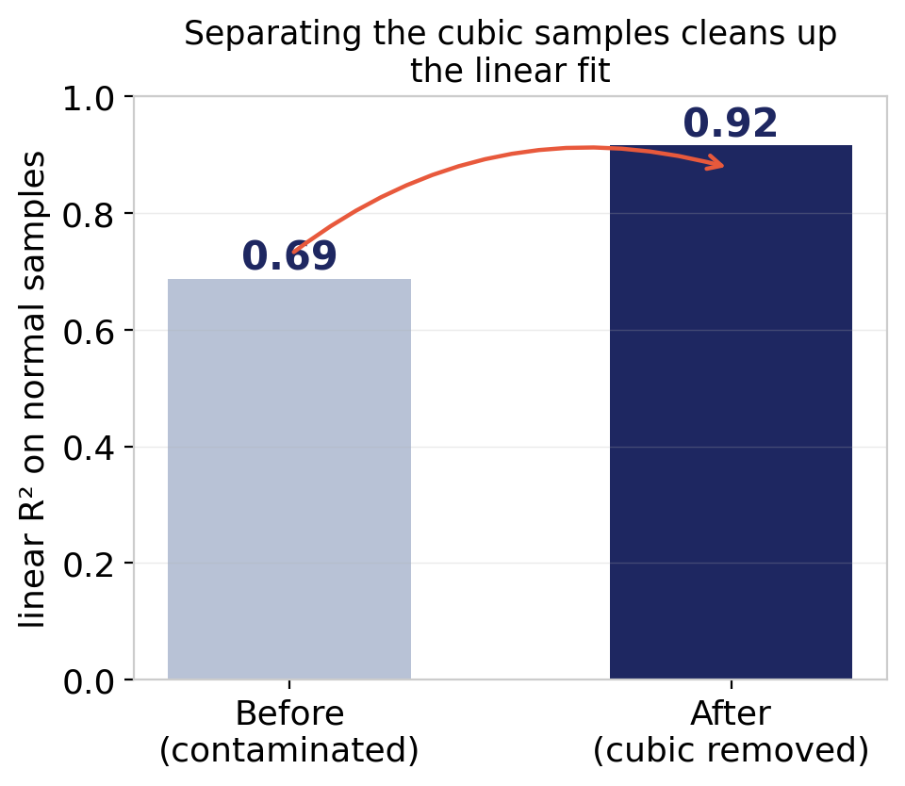
Why not XGBoost?
5 / 6
Why a simple model wins
How I know the structure is real
Tested, and it lost (0.879 vs 0.916). The normal data is genuinely linear — linear regression is the correct family, not just adequate. Trees can’t extrapolate 3·x9³, and the mixture is invisible in the features (AUC 0.49), so complexity recovers nothing.
The strongest evidence: after identifying and removing the cubic samples, the linear fit on normal samples jumps from R² 0.69 to 0.92. If my read of the data were wrong, the improvement would not be this clean. This confirms the “linear + cubic” structure is real, not a coincidence.
Notes:
People always ask why not XGBoost. I tested it. On the cleaned data, gradient boosting scored 0.879 versus 0.916 for the linear model - it does worse. Three reasons: the normal data is genuinely linear so linear regression is the correct family not just adequate; trees cannot extrapolate the cubic term beyond the training range; and the mixture is invisible in the features at AUC 0.49, so added complexity recovers nothing. Finally, how do I know my whole reading is right and not just a story I am telling myself. The strongest evidence is on the right: after I identify and remove the cubic samples, the linear fit on the normal samples jumps from 0.69 to 0.92. If my read of the data were wrong, you would not get an improvement that clean. That confirms the linear-plus-cubic structure is real. To summarize the whole approach: investigate the data, run a baseline to expose the problem, use residuals once to locate the cubic term, infer the true structure, and model that structure. I modeled the data, not a model that wouldn't fit. Thank you.

Slide 7
That’s all :)
Thank you for listening

